Slide 1
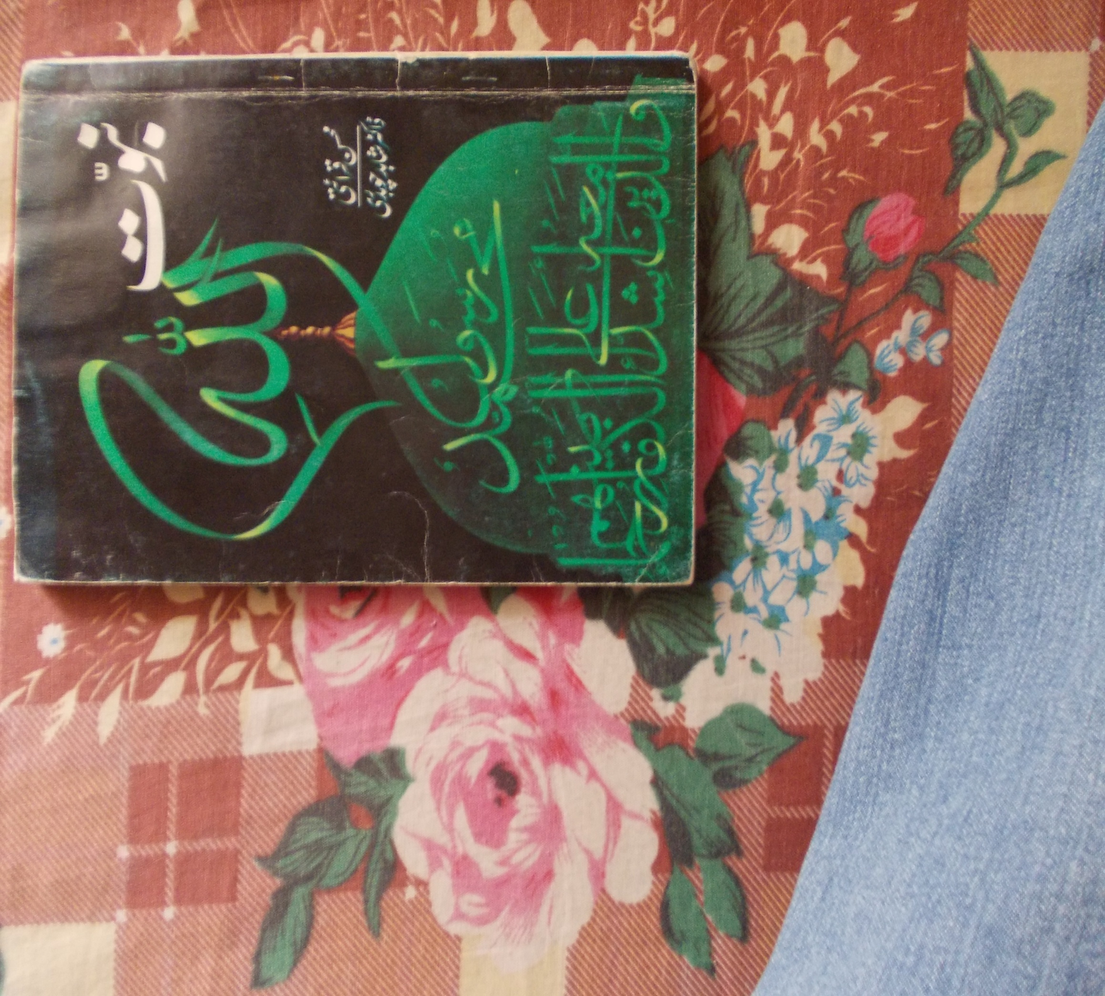
S.M MUJTABA
RC # 1

Slide 2
About Book
Naam-e-kitaab: Nabuwwat
Musannif: Mohsin qariati
Tasdeek: Shahid chaudri

Slide 3
PAIGHAMBARON KI ZARORAT
Elahi nazarya-e-kaainaat
Aqli daleel
  AALIM, AALIM KI BAAT MANAY
  JAHIL, JAHIL KI BAAT MANAY
  AALIM, JAHIL KI BAAT MANAY
  JAHIL, AALIM KI BAAT MANAY
Al- Quran

Slide 4
ANMBIA KI SHANAKHT
Moajza
Moajzay ka tanasub
Sawal

Slide 5
PAIGHAMBARON KI SIFF’AT
Anmbia ki insani zindagi
Paighambaron ka ikhlaaq
Al-Quran
Rasool(s.a.w.w) sb nabiyon say aala ikhlaaq
Natija

Slide 6
Khuda ki bandagui
Pukhta azam
Wafa
Mashwara karna
Ismat(paakezgi)

Slide 7
ANMBIA KA KAAM
Tauheed
Adal
Conclusion

